Slide 1
19I602 - WEB TECH AP
TEAM- 10
TEAM MEMBERS:
ANIRUDDHA L - 22I203
SARAVANA KUMAR S - 22I252
SRI HARI KRISHNA B R - 22I264
VYAS M- 22I274
ARAVIND L - 22I278

Slide 2
File Handling
File handling in Node.js is a crucial part of working with the filesystem to read, write, update, or delete files. Node.js provides the fs (filesystem) module, which is used for file handling operations. The fs module allows both synchronous and asynchronous file handling, giving flexibility based on the use case.

Slide 3
Types of File Handling in Node js
Synchronous File Handling
Asynchronous File Handling

Slide 4
Synchronous File Handling:
Operations are performed one after the other. The program will wait for a file operation to complete before moving to the next task.
Generally less efficient for I/O-bound operations because it blocks other processes.
Asynchronous File Handling:
Operations are non-blocking, allowing other tasks to be processed simultaneously. A callback function is used to handle the completion of the operation.
Ideal for I/O-heavy applications as it does not block the event loop.

Slide 5
Reading Files:
You can read a file asynchronously or synchronously using methods provided by the fs module.
Syntax:
Asynchronous:
fs.readFile(path, options, callback)
Synchronous:
fs.readFileSync(path, options)

Slide 6
Code Snippet:
const fs = require('fs');
fs.readFile('example.txt', 'utf8', (err, data) => {
// Asynchronous read
if (err) {
return console.error(err);
}console.log("Asynchronous read: " + data);
});
// Synchronous read
const data = fs.readFileSync('example.txt', 'utf8');
console.log("Synchronous read: " + data);

Slide 7
Writing Files:
Files can be written either synchronously or asynchronously using fs.writeFile or fs.writeFileSync.
Syntax:
Asynchronous:
fs.writeFile(path, data, options, callback)
Synchronous:
fs.writeFileSync(path, data, options)

Slide 8
Code Snippet:
const fs = require('fs');
// Asynchronous write
fs.writeFile('example.txt', 'Hello World!', (err) => {
if (err) {
return console.error(err);
}
console.log('Asynchronous write complete.');
});
// Synchronous write
fs.writeFileSync('example_sync.txt', 'Hello Sync World!');
console.log('Synchronous write complete.');

Slide 9
Appending Files:
You can append data to a file using fs.appendFile or fs.appendFileSync.
Syntax:
Asynchronous:
fs.appendFile(path, data, options, callback)
Synchronous:
fs.appendFileSync(path, data, options)

Slide 10
Code Snippet:
const fs = require('fs');
// Asynchronous append
fs.appendFile('example.txt', '\nAppended Text', (err) => {
if (err) {
return console.error(err);
}
console.log('Asynchronous append complete.');
});
// Synchronous append
fs.appendFileSync('example_sync.txt', '\nAppended Sync Text');
console.log('Synchronous append complete.');

Slide 11
Deleting Files:
You can delete files using fs.unlink for asynchronous or fs.unlinkSync for synchronous deletion.
Syntax:
Asynchronous:
fs.unlink(path, callback)
Synchronous:
fs.unlinkSync(path)

Slide 12
Code Snippet:
const fs = require('fs');
// Asynchronous file delete
fs.unlink('example.txt', (err) => {
if (err) {
return console.error(err);
}
console.log('Asynchronous file deleted.');
});
// Synchronous file delete
fs.unlinkSync('example_sync.txt');
console.log('Synchronous file deleted.');

Slide 13
Renaming Files:
You can rename files using fs.rename or fs.renameSync.
Syntax:
Asynchronous:
fs.rename(oldPath, newPath, callback)
Synchronous:
fs.renameSync(oldPath, newPath)

Slide 14
Code Snippet:
const fs = require('fs');
// Asynchronous rename
fs.rename('oldname.txt', 'newname.txt', (err) => {
if (err) {
return console.error(err);
}
console.log('Asynchronous rename complete.');
});
// Synchronous rename
fs.renameSync('oldname_sync.txt', 'newname_sync.txt');
console.log('Synchronous rename complete.');

Slide 15
ERROR HANDLING
Error handling is the process of anticipating, identifying, and managing errors or exceptions that can occur during the execution of a program or system, ensuring that the application remains stable and user-friendly

Slide 16
Synchronous Error Handling
The errors that occur during the execution of synchronous code, can be caught using try-catch blocks.

Slide 17
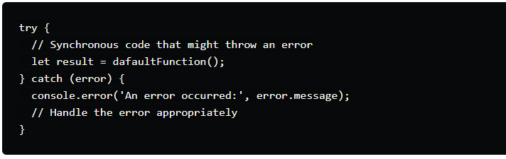

Slide 18
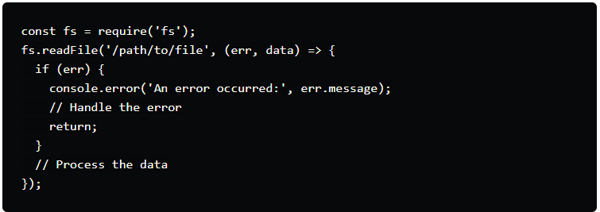
Asynchronous Error Handling
Callbacks: In callback-based asynchronous code, errors are usually the first argument in the callback function

Slide 19
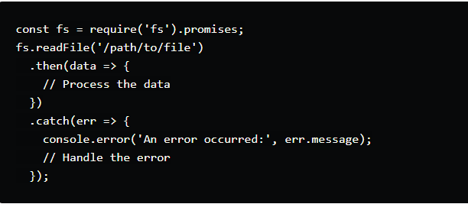
Promises
Promises offer a cleaner way to handle asynchronous errors using .catch()

Slide 20
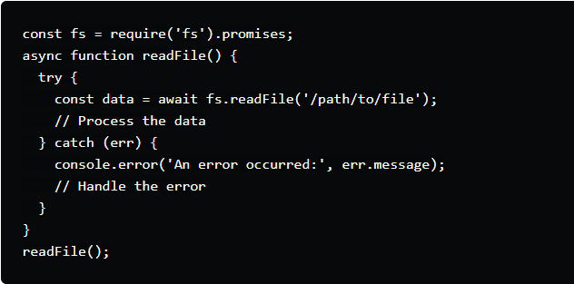
Async/Await
Async/await syntax allows for a more synchronous style of error handling in asynchronous code

Slide 21
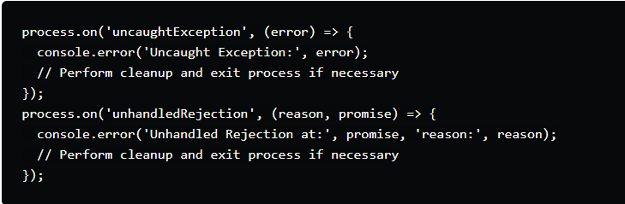
Advanced Techniques
Global Error Handling
Handling uncaught exceptions and unhandled promise rejections ensures that no errors slip through unnoticed

Slide 22
Centralized Error Handling
For larger applications, centralized error handling can help manage errors more effectively. This often involves middleware in Express.js applications.
Express.js Middleware
Express.js provides a mechanism for handling errors via middleware. This middleware should be the last in the stack:

Slide 23
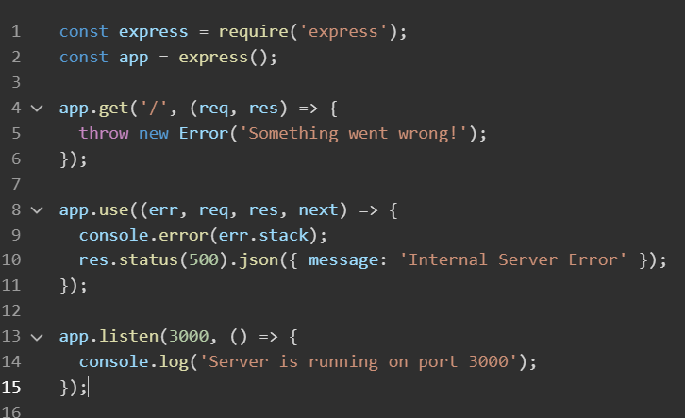

Slide 24
Advanced Techniques
Custom Error Classes
Instead of throwing generic errors, create custom error classes to categorize different types of errors.
Helps differentiate between system errors and application-specific errors
Enables better debugging and logging

Slide 25
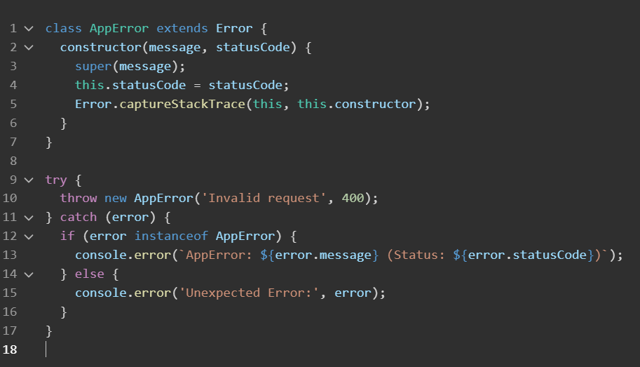

Slide 26
Error Logging
Implement robust error logging to monitor and diagnose issues. Tools like Winston or Bunyan can help with logging.
Stores error logs for future analysis.
Can be integrated with cloud logging services.
Helps track errors in production.
Essential for application maintenance.

Slide 27
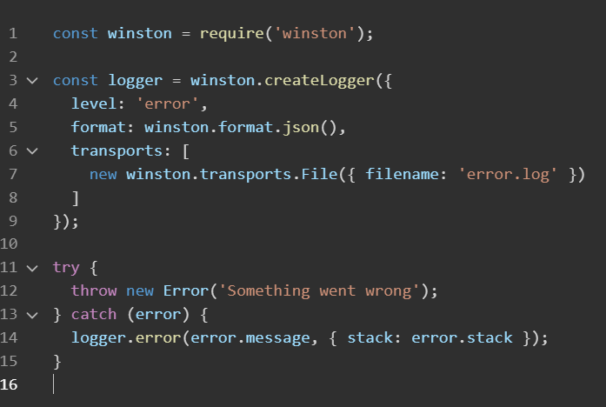

Slide 28
Handle Errors Early and Often
Proactive Error Handling:
Use try...catch for synchronous code and catch() for promises to address errors immediately.
Centralized Logging and Monitoring :
Use logging tools and monitoring systems to track, report, and debug errors efficiently.
Validation, Testing, and Graceful Shutdown:
Validate user inputs early (e.g., with Joi or express-validator) to prevent invalid data errors.

Slide 29
Don't Swallow the Error
Swallowing errors (i.e., catching them without handling or logging them) hides important issues that could lead to bigger problems later on. Always log or rethrow errors to maintain visibility and track root causes.
When errors are swallowed, it becomes significantly harder to debug. Proper error logging is crucial for real-time monitoring and post-mortem analysis of production issues.

Slide 30
Providing Meaningful Error Messages
Error messages should clearly describe what went wrong, not just indicate that something failed. This helps developers and users quickly understand the issue.
When possible, avoid technical terms in error messages that might confuse non-developers, especially for end-user-facing messages. Keep the message simple and actionable.
Include unique error codes or identifiers, especially for production environments

Slide 31
THANK YOU

